Slide 1

Programming Introduction
By Deborah R. Fowler

Slide 2

Programming
VSFX 160 / 705
Linux/Bash
Houdini
Notes:
This class will introduce programming using python. Later in the quarter you will learn about linux and shell scripting using bash. Then we will introduce Houdini and some of the languages used inside the package.

Slide 3

Programming != Math != Proceduralism
Notes:
Programming, Math, Proceduralism are distinct concepts, although they play nice together, they are not the same thing

Slide 4
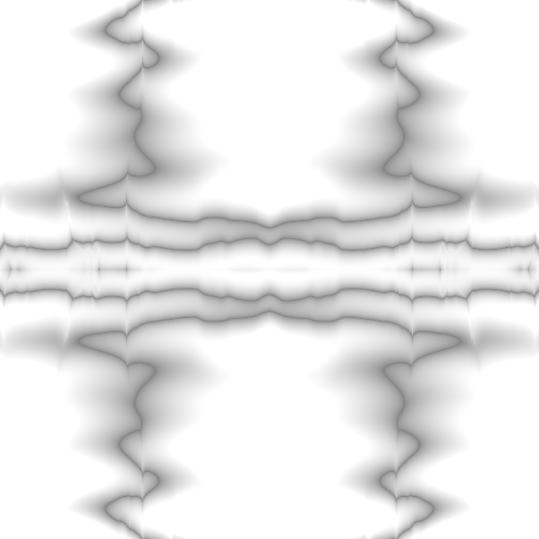
Programming == Problem Solving
Notes:
Programming is about problem solving

Slide 5

  variables
  truth statements
  looping
  functions
  I/O
  lists
  classes/objects
  OOP
KEY CONCEPTS
Notes:
Overview of the concepts covered

Slide 6


Python
interpreted
“less” syntax
all about format
Notes:
Let’s focus on python first

Slide 7

How will we use it?
IDLE on Windows
Linux
Tkinter/turtle
Many libraries
Notes:
Main tools that we will be using

Slide 8
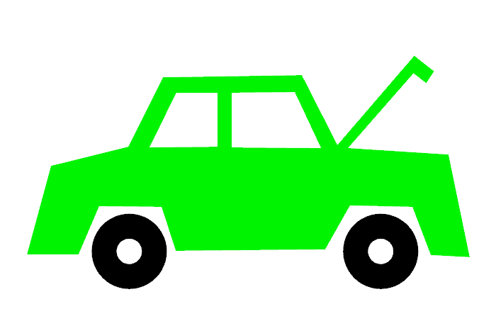
Version 3.X
On Windows:
Use IDLE (very basic interface or IDE – Integrated Developers Environment – Discuss)
At Home: Type IDLE in the start menu
At Monty: (if it is not in the start menu)
right click any file with .py extension and select IDLE
Even better – work on linux
Python Shell
how do I get one?
Python Shell
How do I get one?
Notes:
IDLE comes up as a python shell – it is really a very simple IDE
An IDE is designed to make coding easier

Slide 9
On Linux:
Type python
You can use a text editor like gedit or geany – idle is also available as well as pycharm
At home you might want to try sublime
To run a python program type
python filename.py
Python Shell
On Linux
Notes:
We will be using Linux later in the quarter – if you are familiar to linux you are welcome to use it. If you are not, first we will learn programming in python, then switch to linux and sprinkle in a little bash shell scripting

Slide 10

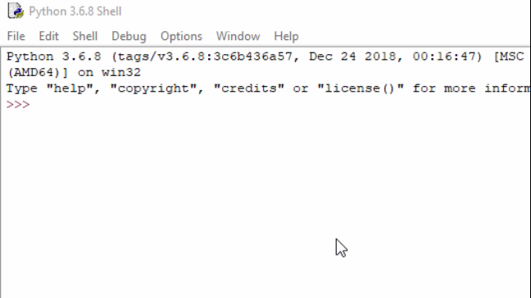
Introducing IDLE
Notes:
IDLE can be used interactively – PLAY VIDEO

Slide 11
We have introduced two concepts:
Variables and Operators
Notes:
In the example, we introduced variable and operators

Slide 12

Python
x = 3
variables
for storing information
Notes:
If I asked you what 200 times 60 is, you could probably do that in your head 12,000 but what if I asked you to remember that number until the end of the lecture? You would likely write it down.

Slide 13

Most languages have built-in mathematical operations
+ addition
- subtraction
* multiplication
/ division (be careful with integers)
% modulus
(remainder on integer division)
Operators
Notes:
Most of these symbols you are familiar with. We use * for multiplication because x is a letter which could be a variable. You may not be familiar with modulus – it will come up later on in the quarter and is very useful.

Slide 14

variable literally means something that can change value
stores data – all kinds – names, numeric values, memory addresses etc.
in python they are not “typed” and do not need to be declared beforehand …
variables
Notes:
A variable is a way of remembering something, storing information, but that information can change. Let’s look at python again

Slide 15

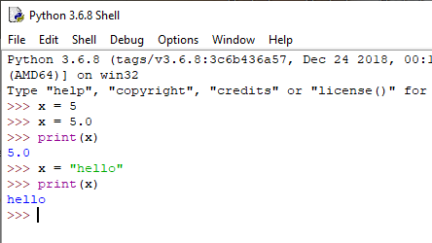
What does that mean in python?
Notes:
Variables in python can change value or type

Slide 16

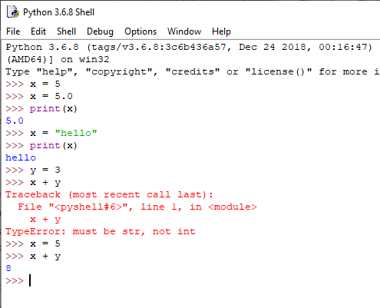
You still must know what you are doing:
x + y will not work if x is a string
Notes:
You still need to be aware of the type of the variable

Slide 17
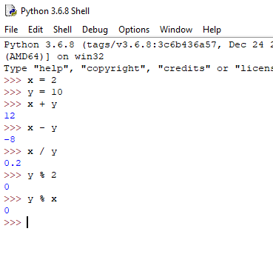
Operator awareness
New in python 3
both integers but
gives correct result
Modulus –
remainder on integer division
Notes:
There are a few things to be aware of regarding operators as well

Slide 18

Relational Operators
    == equals
    != not equal
    < less than
    > greater than
    >= greater than or equal to
    <= less than or equal to

Slide 19
Truth statements
For selecting code
if condition:
do something
Notes:
Truth statements

Slide 20
truth statements – for selecting in Python
if x == 3:
y = 1
else:
y = 2
Notes:
Truth statements allow selection – its that proverbial fork in the road

Slide 21
truth statements – add another line in else?
if x == 3:
y = 1
else:
y = 2
x = 4
Notes:
Python delineates blocks with white space, C-like languages delineate with curly braces
There are also, other variants of truth statements, switch, elif (else if) etc, but this gives you a flavor

Slide 22
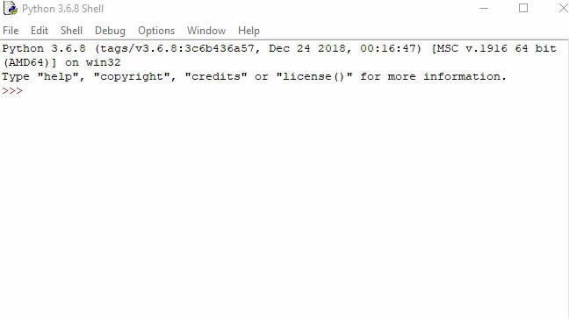
Test in IDLE
(don’t be fooled by the prompt when indenting)
Notes:
Here is an if statement in IDLE. PLAY VIDEO

Slide 23

x = 4
if x == 3:
y = 1
else:
y = 2
NOTES to explain:
Formatting delineates blocks
python code is saved in a .py file
IDLE is an interactive shell
python is an interpreted language
Notes:
Formatting is very important. Next, let’s see how to create a .py file in IDLE

Slide 24
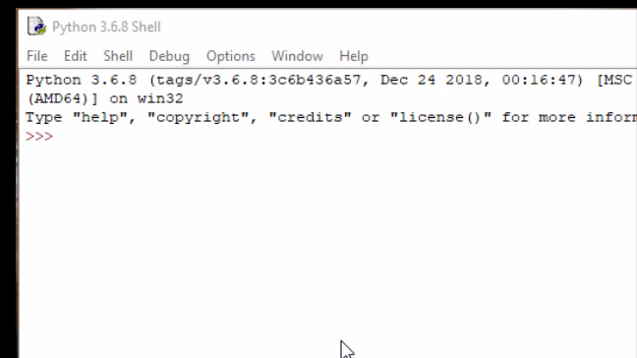
Python file
test.py
Notes:
Instead of using the interactive shell, we will use the editing window and create a file called ifexample.py
PLAY VIDEO.

Slide 25
IMPORTANT DISTINCTION between Python file versus an interactive python shell
File saves your work, you can run it again and again
Shell is temporary – interactive session. Goes away once you close the shell
Notes:
To be clear, a python shell is temporary (great for testing). A python file saves your work and can be run – script or program.

Slide 26

Never be afraid/ashamed to look up syntax
Your brain is needed for problem solving, not for memorizing rules
As you use it daily, it will become familiar
Notes:
Look things up – google is your friend – but always reference your source!

Slide 27
in-class exercise:
Write a program that prints “Hello World” in a .py file in IDLE

Slide 28

  variables
  truth statements
  looping
  functions
  I/O
  lists
  classes/objects
  OOP
KEY CONCEPTS
Notes:
So far we have covered variables and truth statements, before we go one we will introduce turtle graphics

Slide 29
homework:
http://deborahrfowler.com/
pointers to information
documentation/resources
exercise instructions
Notes:
Look over my website – in particular the course notes and the python resources

